Slide 1
Heart Disease Diagnostic Analysis
By- Kumari Neha

Slide 2
Introduction
Health is the true wealth of life, and the COVID-19 pandemic reminded us of its importance.
Heart disease is one of the leading causes of health problems worldwide, affecting people regardless of age, gender, or social status.
By analyzing heart disease data, we can uncover valuable insights to prepare better for the future and improve healthcare strategies.

Slide 3
Objective
The main goal is to analyze a heart disease diagnostic dataset to understand key factors affecting heart disease, compare attributes like age and gender, and identify important patterns.
This project will also create a dashboard for visualizing the findings and supporting future healthcare decisions.

Slide 4
Scope
Analyze heart disease rates across different groups, such as gender and age.
Identify significant relationships between attributes like cholesterol, blood pressure, and heart disease.
Provide clear visualizations and dashboards for easy understanding.
Offer insights to support preventive measures and healthcare improvements.

Slide 5
Steps
Collect and clean the heart disease dataset.
Prepare the data by normalizing and encoding it.
Analyze the data to find trends and patterns.
Build an interactive dashboard with key metrics.
Identify risk factors and provide recommendations.

Slide 6
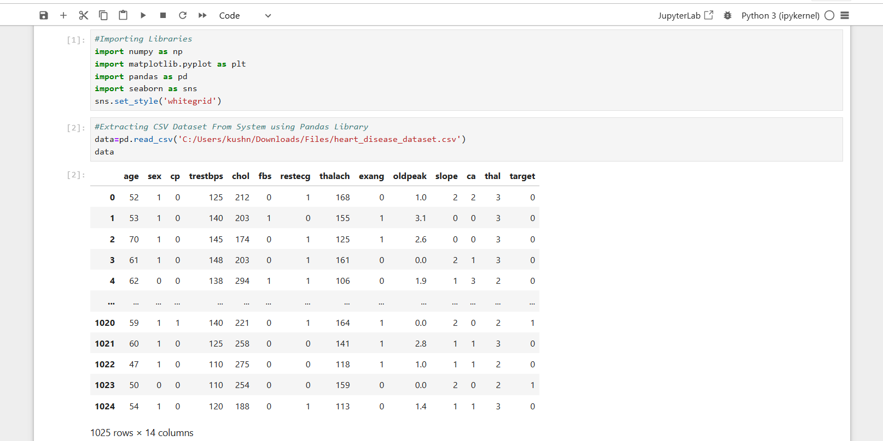

Slide 7
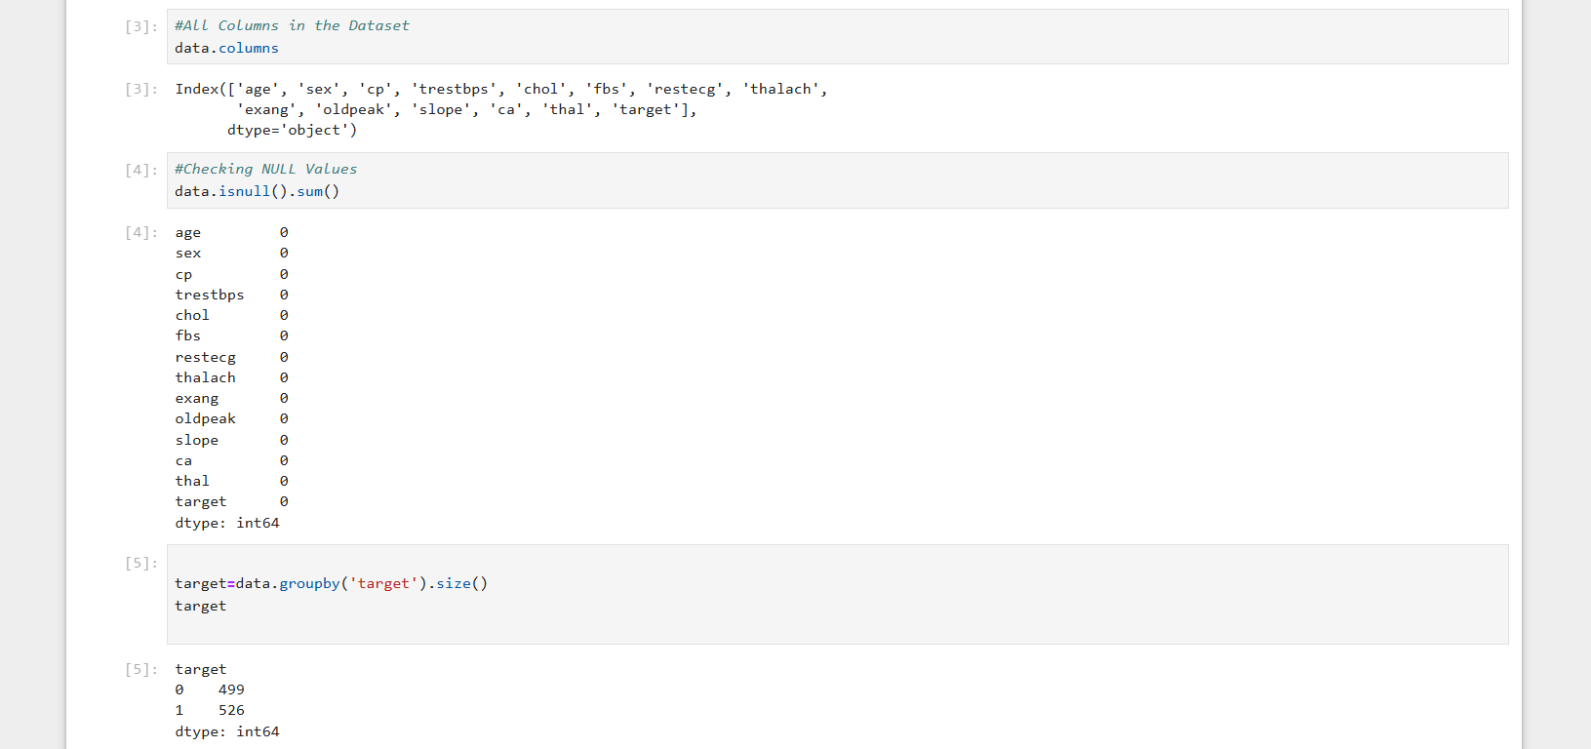

Slide 8
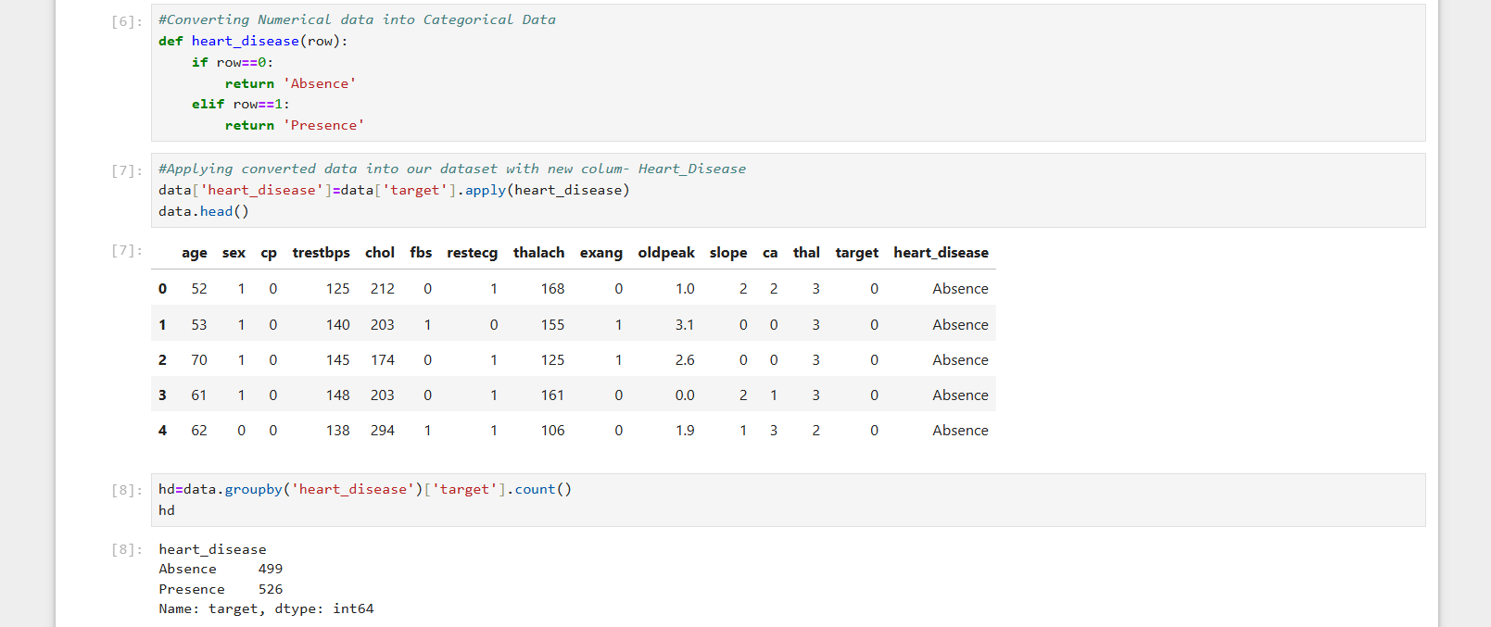

Slide 9
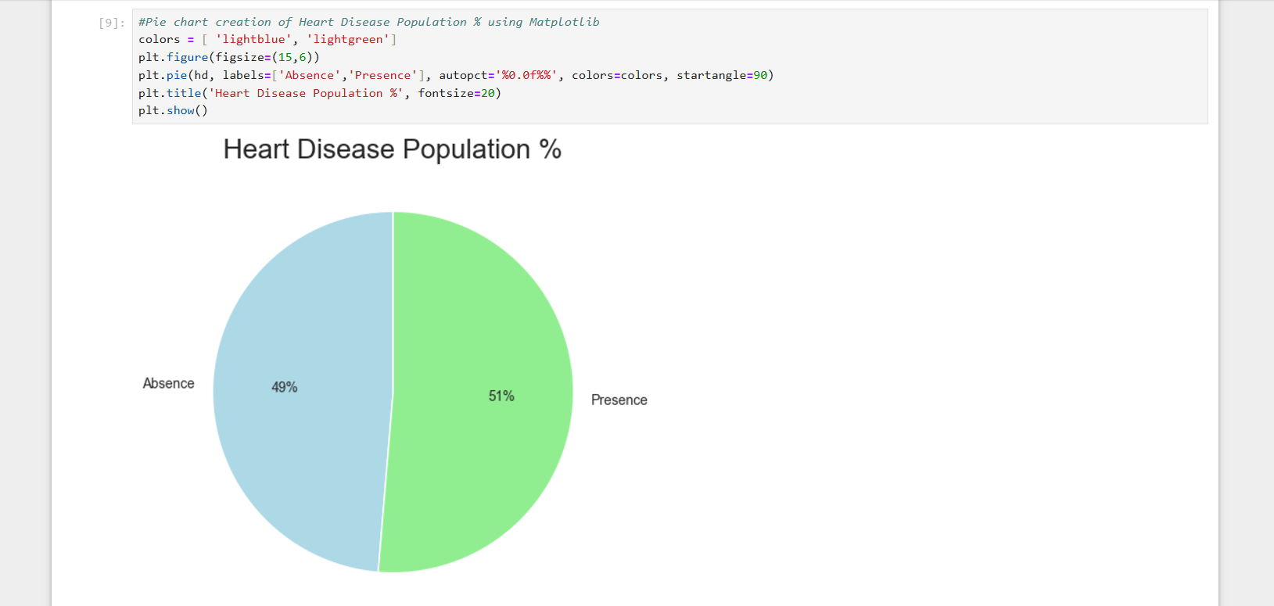

Slide 10
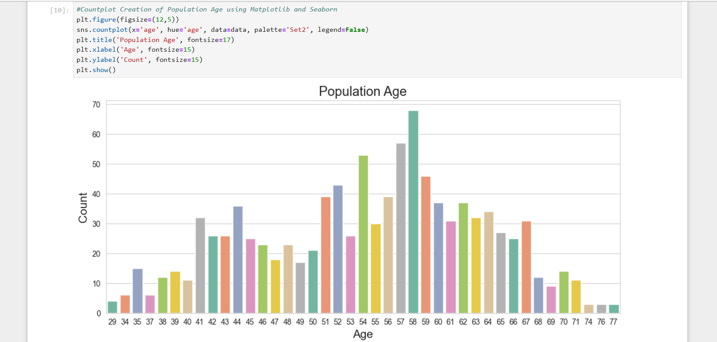

Slide 11
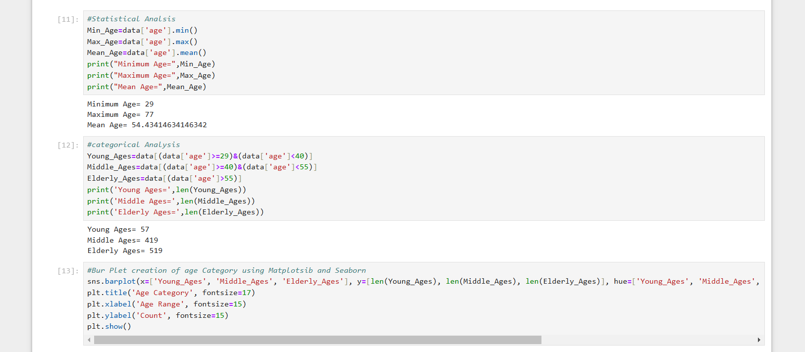

Slide 12
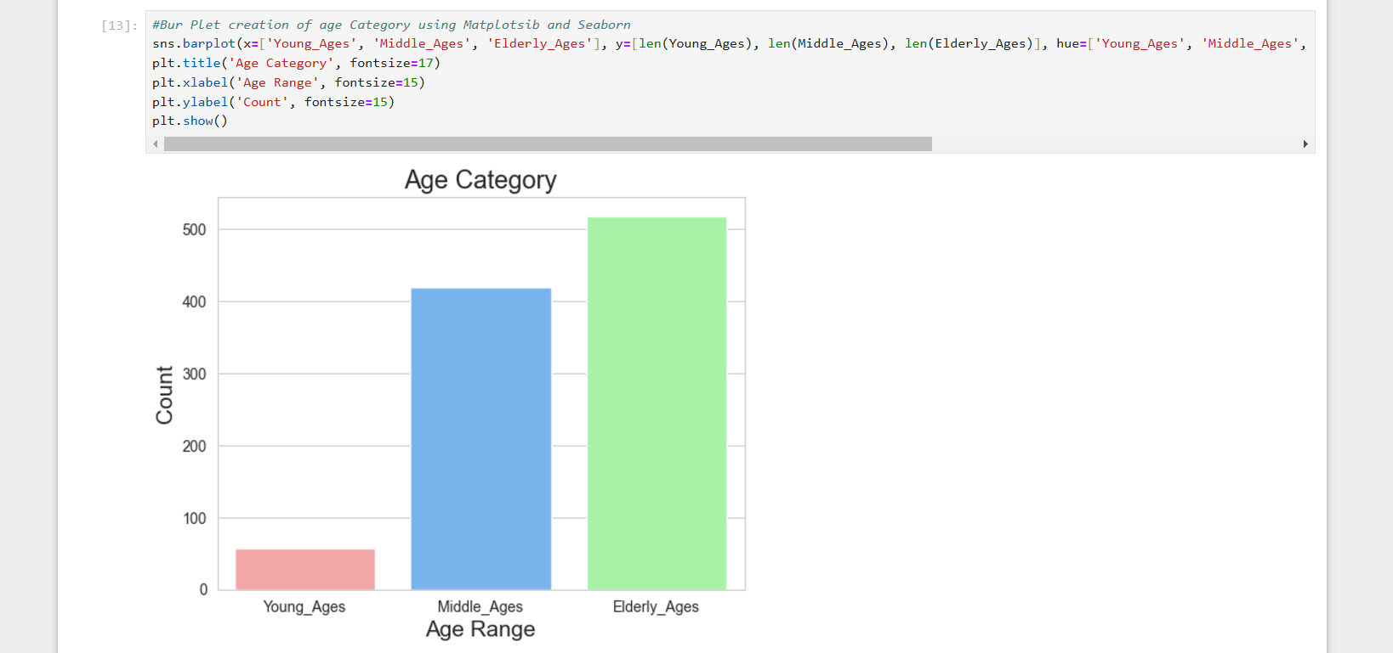

Slide 13
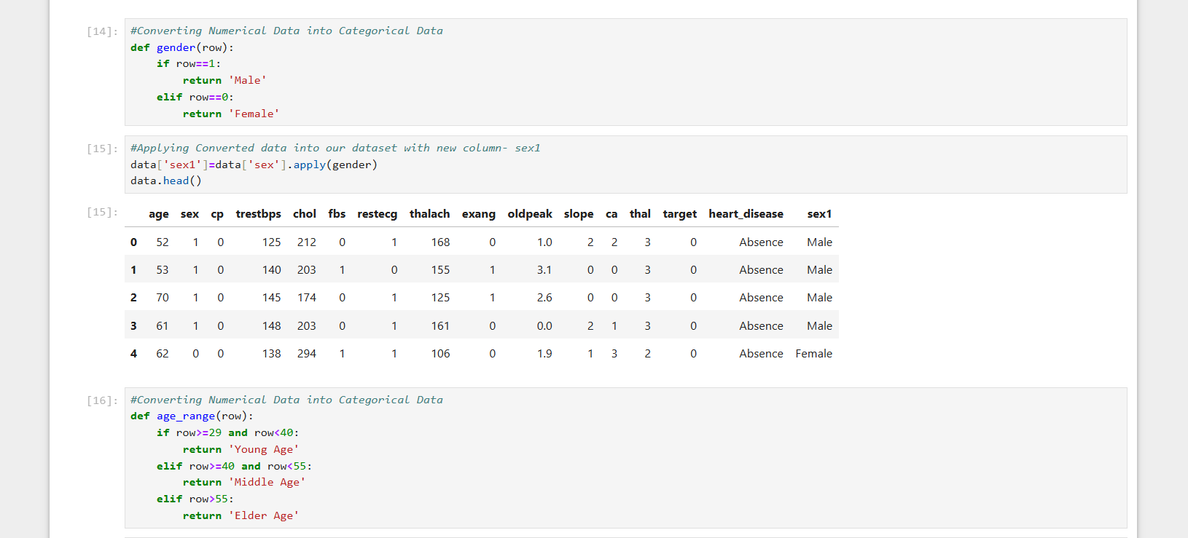

Slide 14
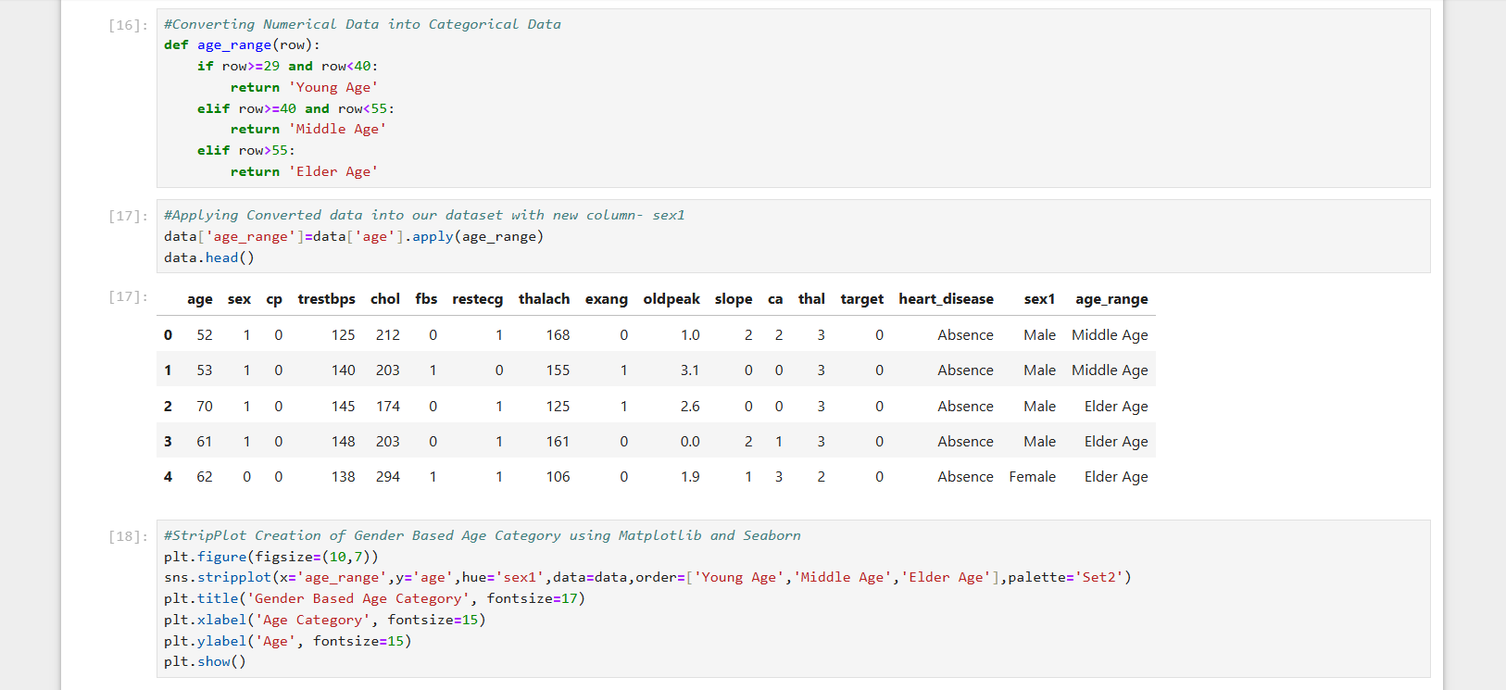

Slide 15
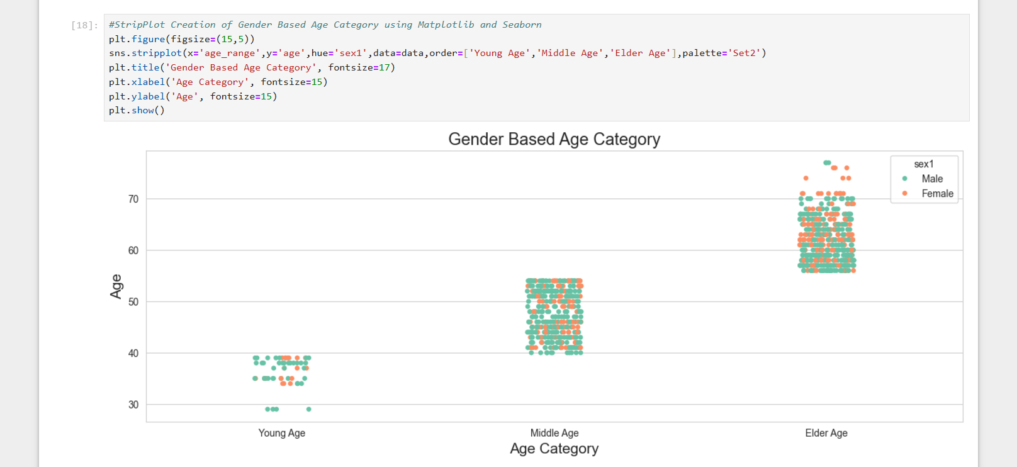

Slide 16
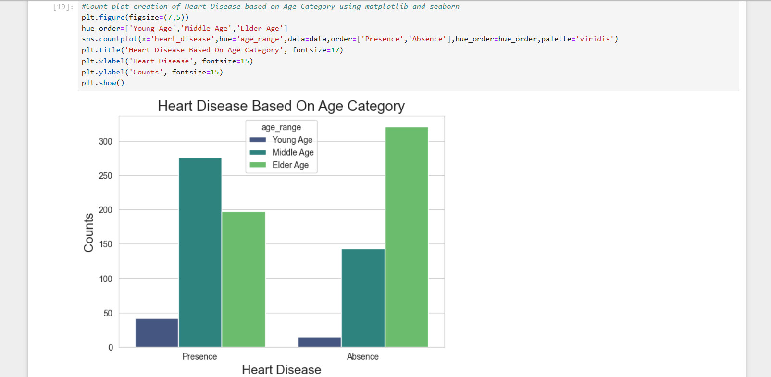

Slide 17
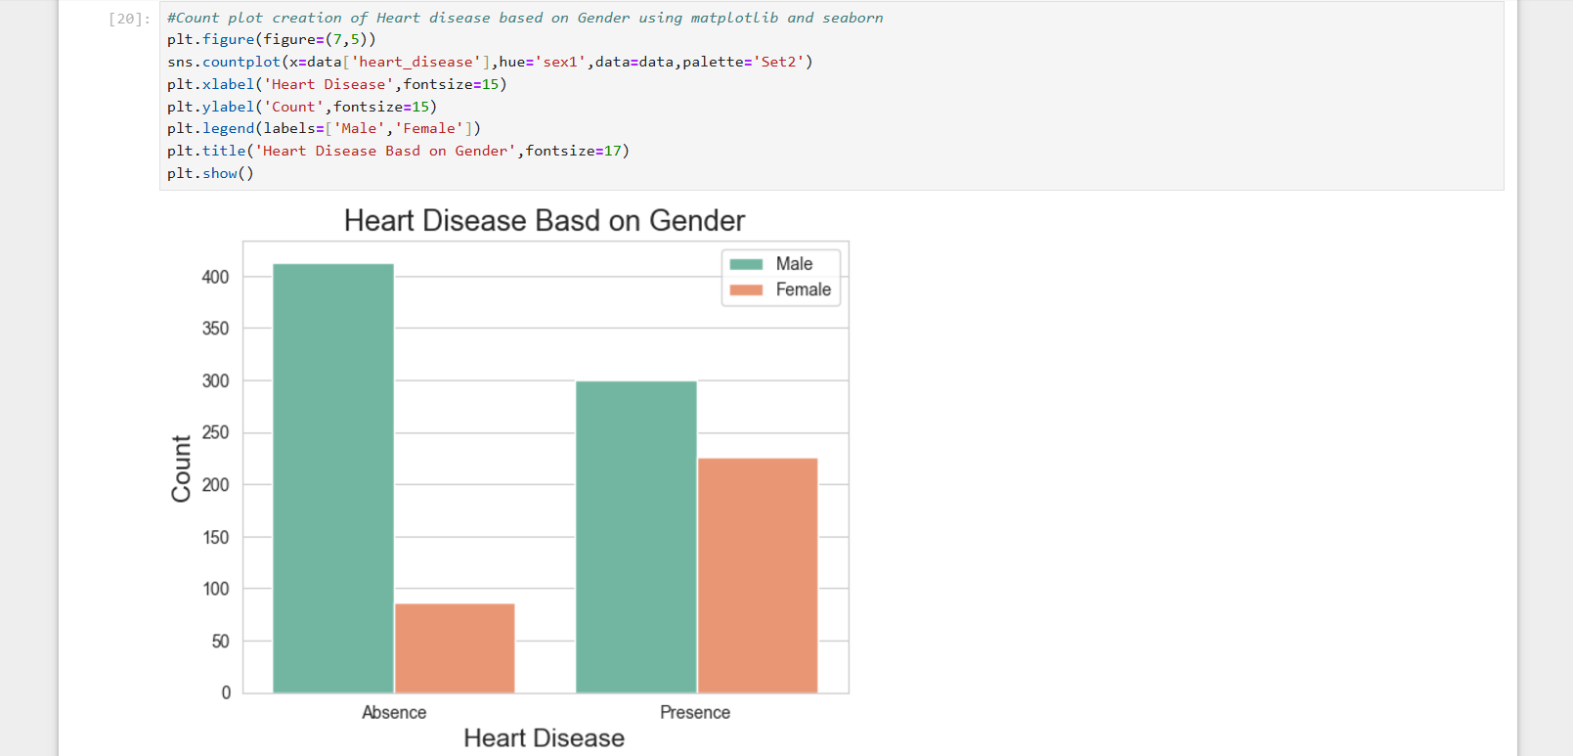

Slide 18
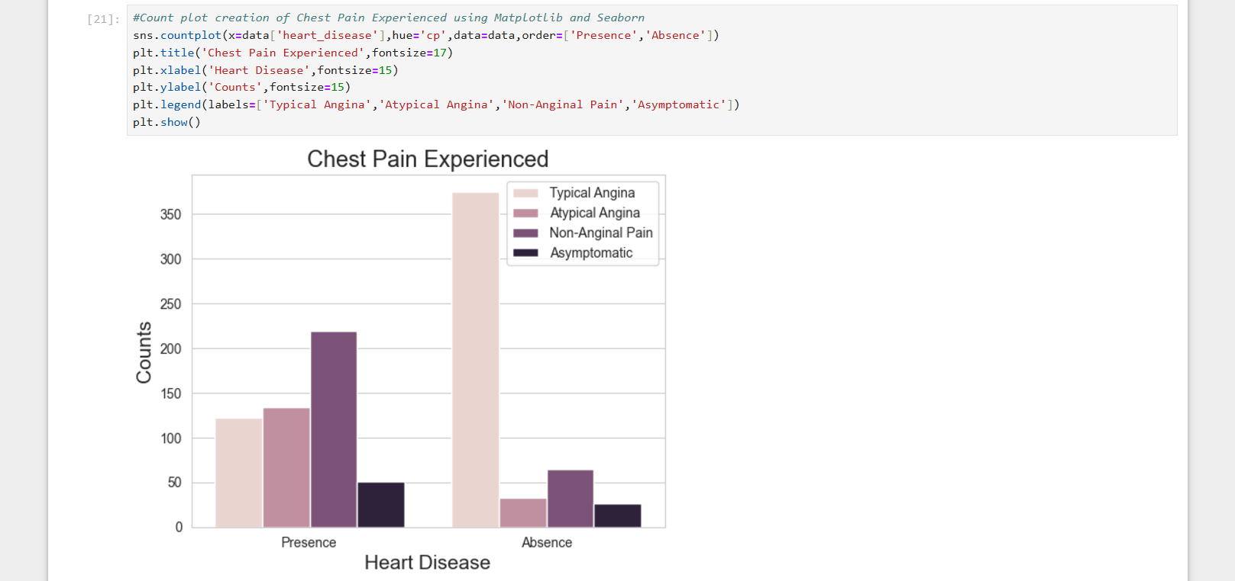

Slide 19
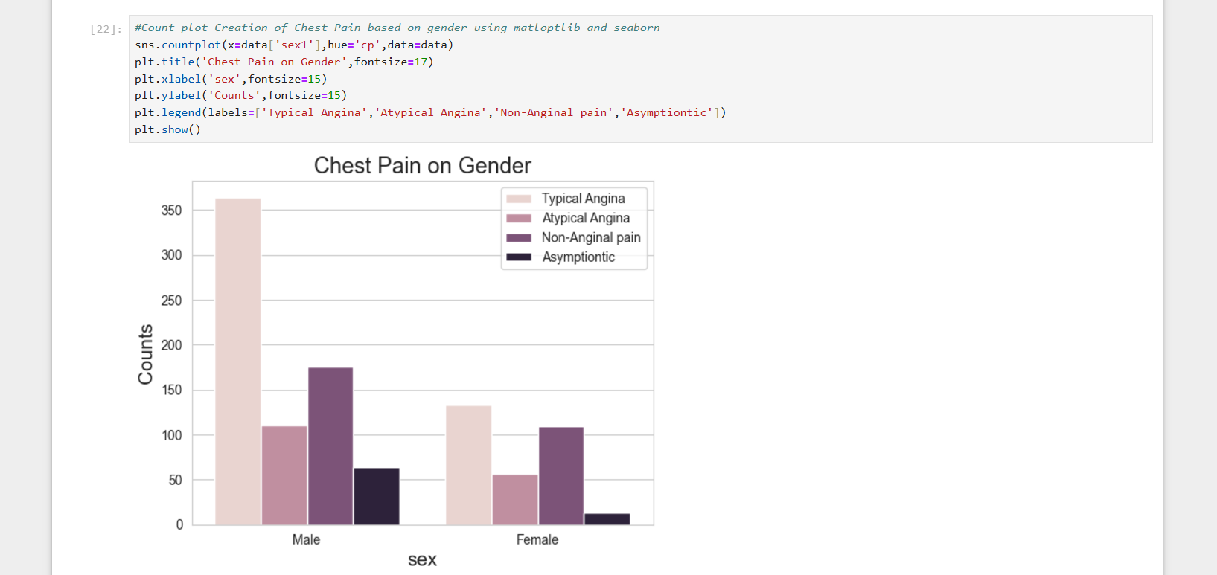

Slide 20
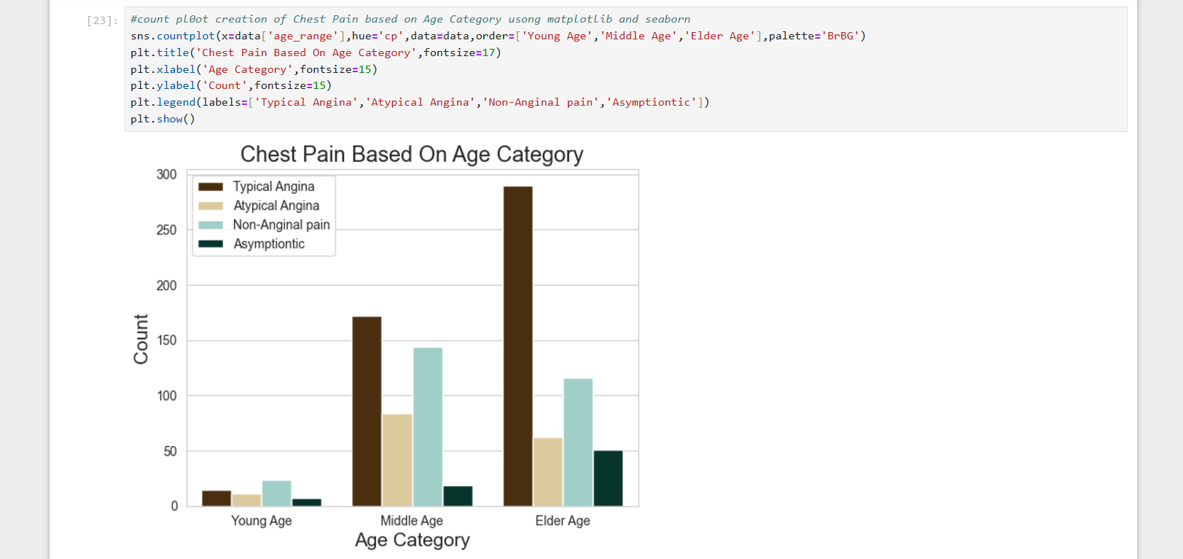

Slide 21
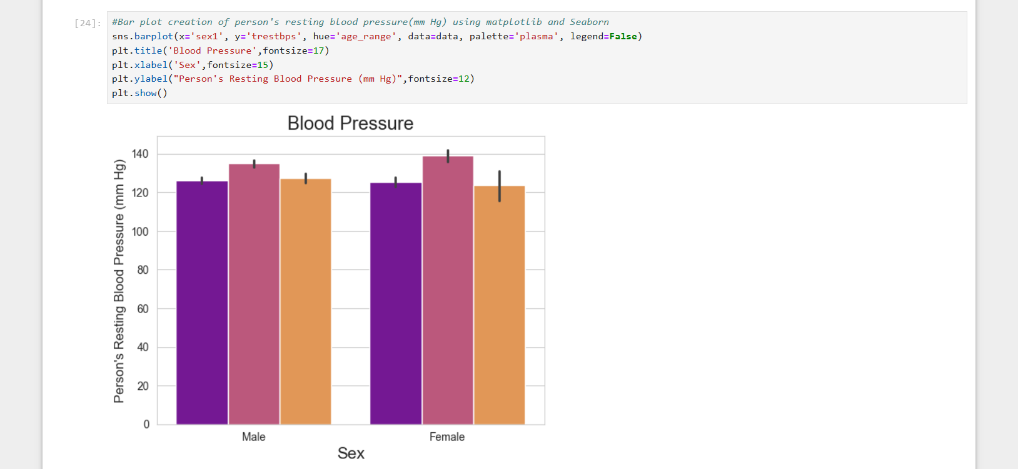

Slide 22
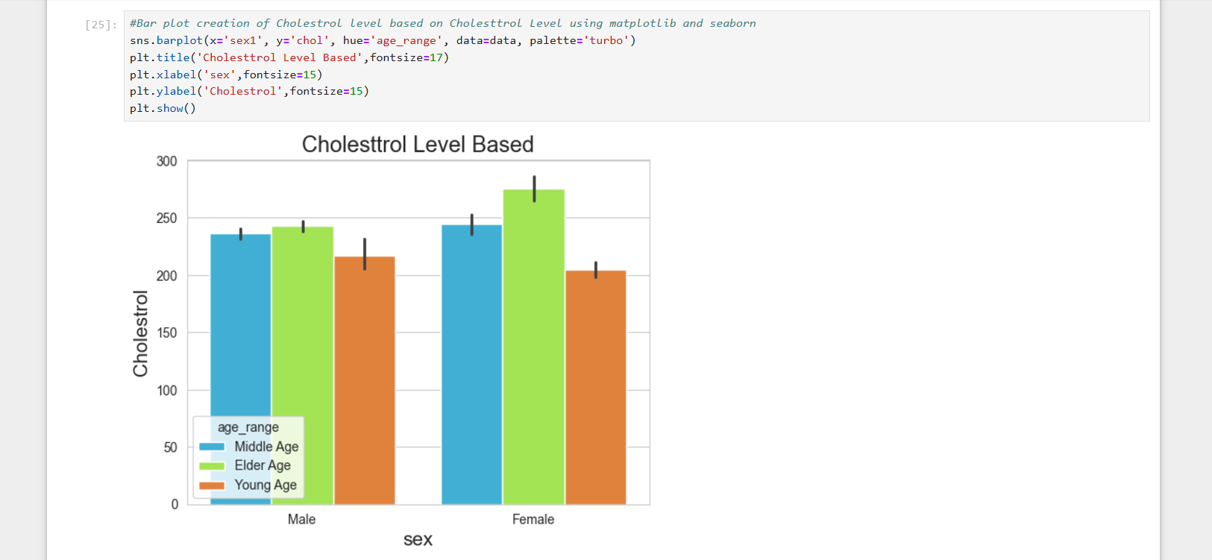

Slide 23
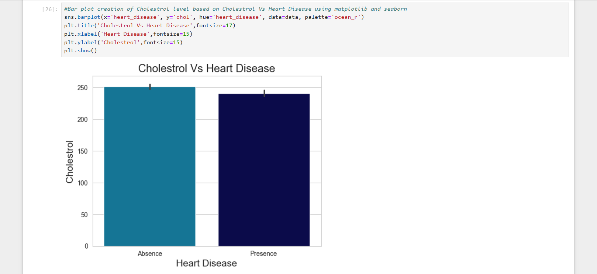

Slide 24
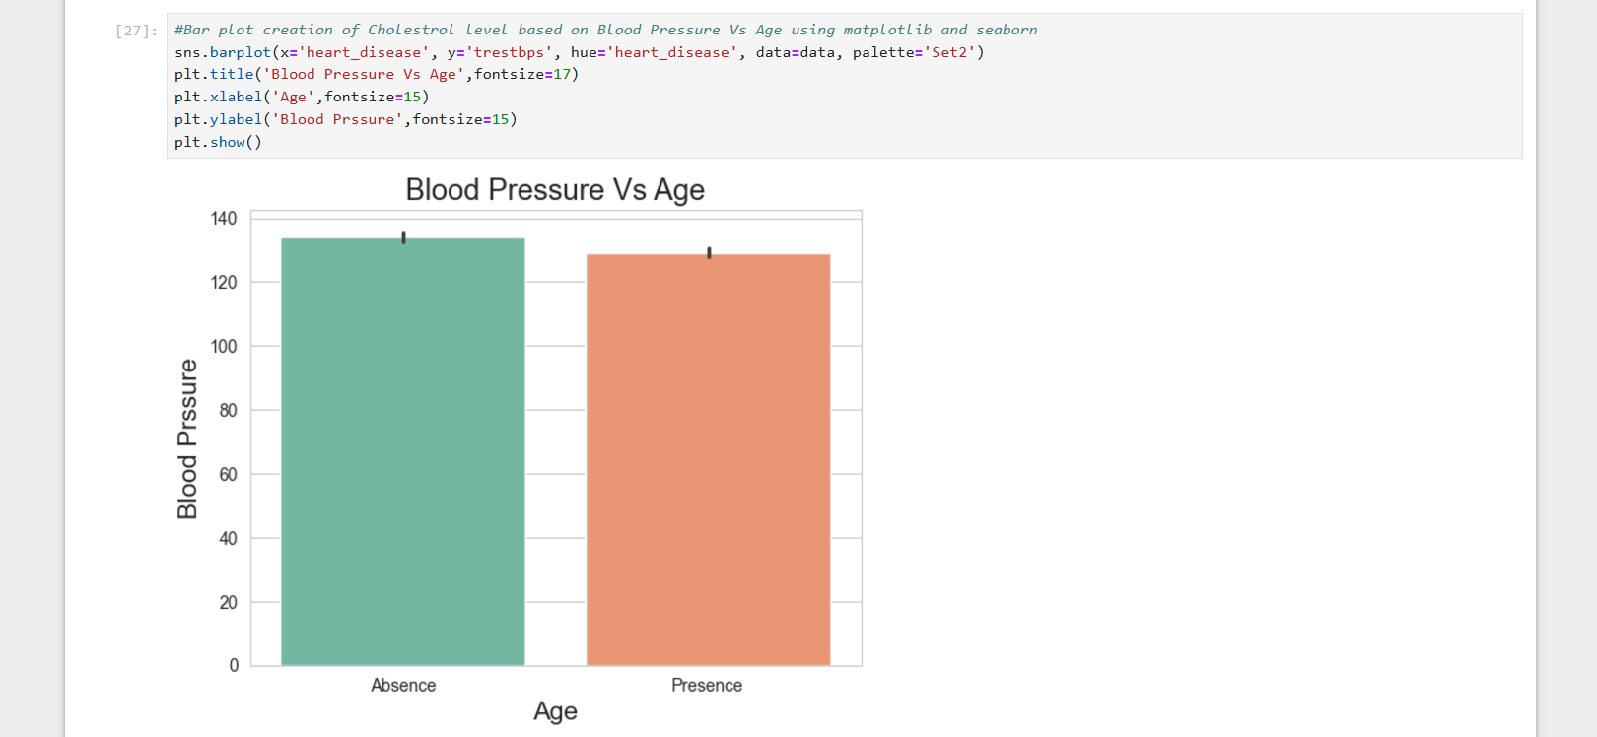

Slide 25
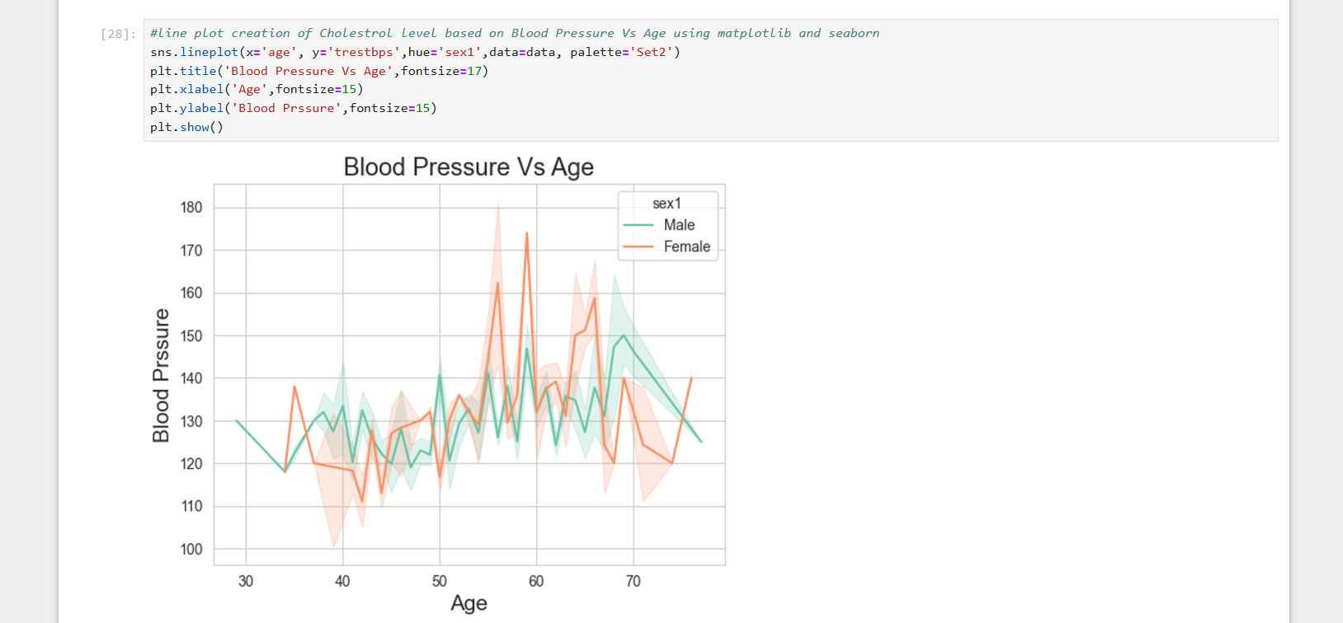

Slide 26
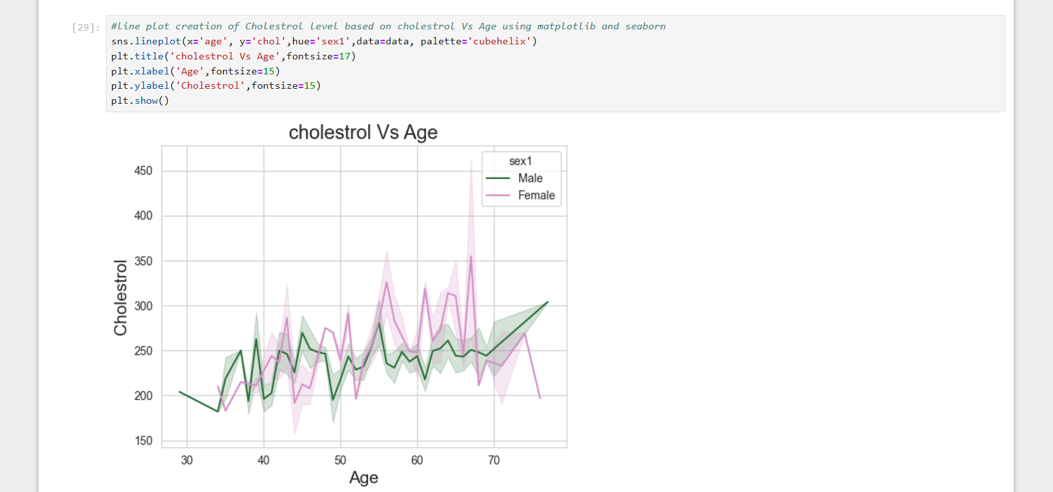

Slide 27
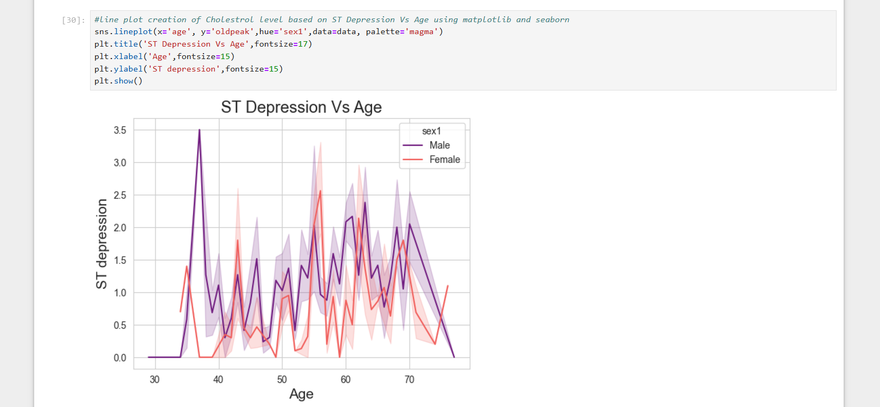

Slide 28
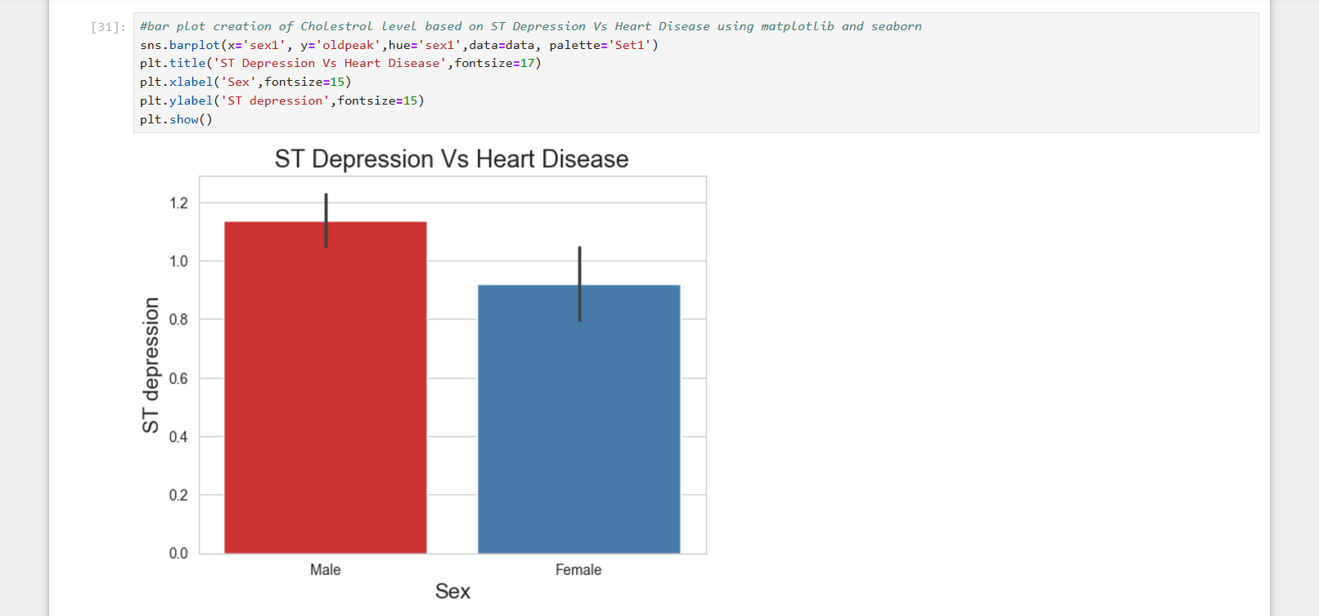

Slide 29
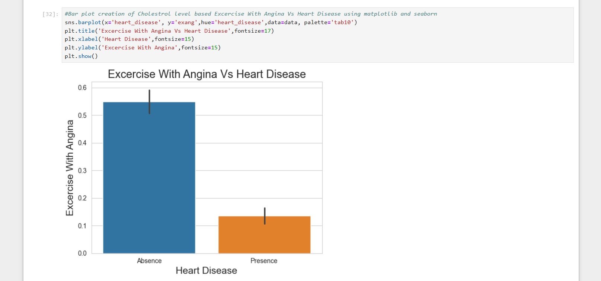

Slide 30
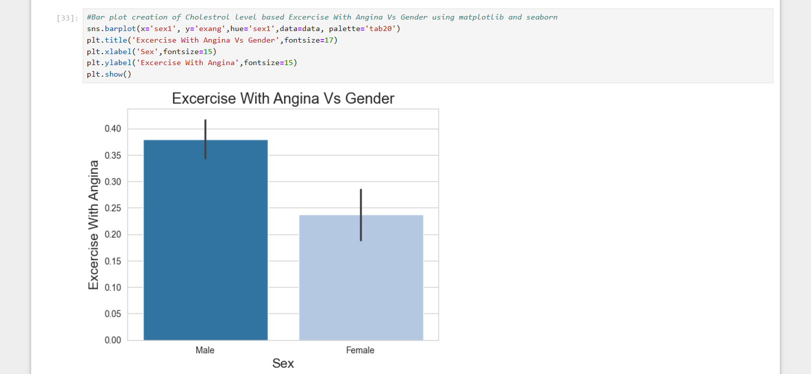

Slide 31
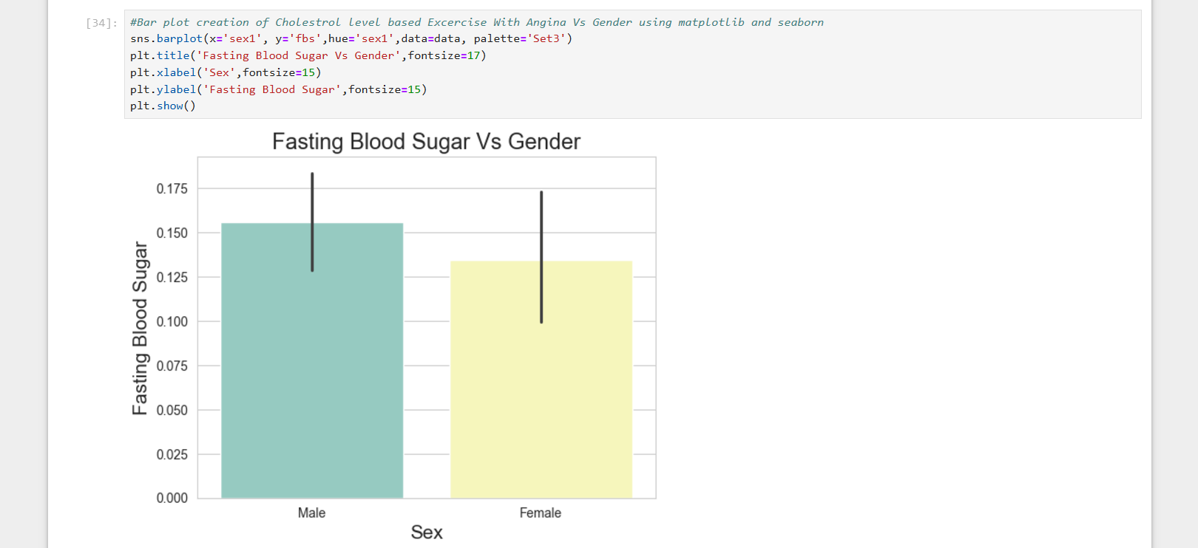

Slide 32
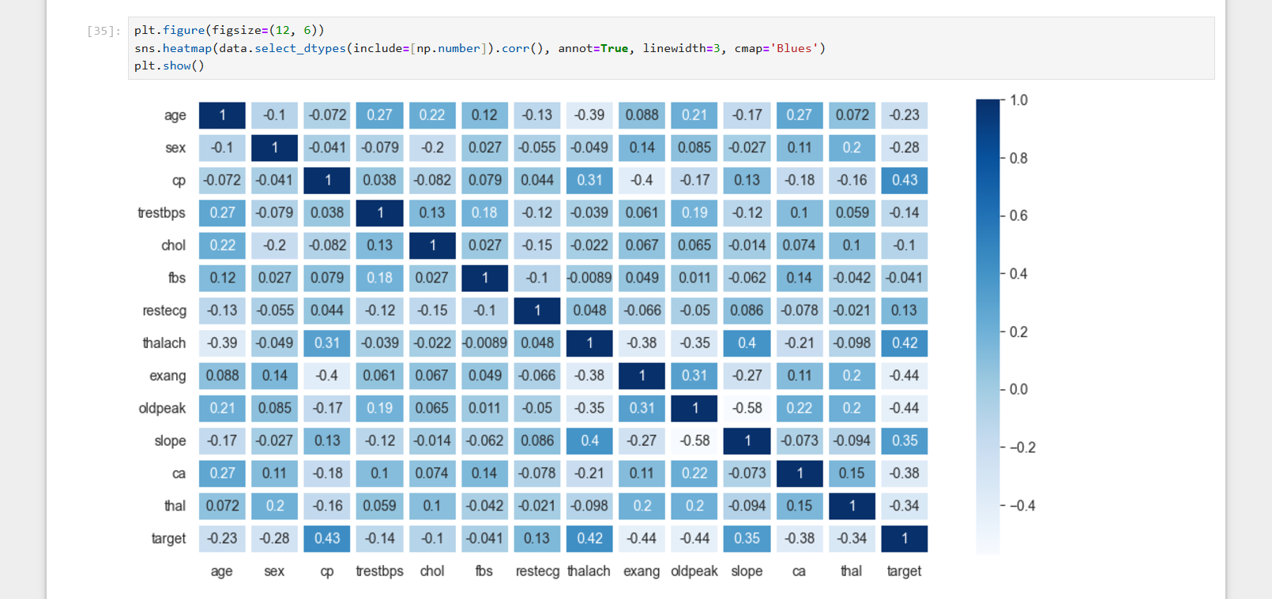

Slide 33
Conclusion
Analyzing heart disease data helps us understand who is at risk and why.
By finding patterns in age, gender, and health attributes, we can make informed decisions to improve healthcare policies.
This project’s dashboard and findings will contribute to creating a healthier future through better planning and preparation.

Slide 34
Thank You

